Slide 1
Friends of Poynton Pool (FoPP) Poynton Spillway Proposal Public Briefing Poynton British Legion
18 April 2024

Slide 2
Agenda
Introductions and background
Planning application update
FoPP alternative spillway options
What comes next?
Q&A

Slide 3
Friends of Poynton Pool Volunteers
A group of locals came together due to a shared appreciation of Poynton Park, its trees and its wildlife. Below are some of our members here to answer questions today:
Mike Ellison – Chair and Tree Consultant
Stewart Tennant – Chartered Engineer and Fellow of the Institution of Civil Engineers
John Borthwick – Structural and Civils Designer
Gwenda Mayers – Vice chair
Jen Hartshorne – Treasurer and Social Media
Elaine Adam – Secretary

Slide 4
Introduction
FoPP DOES NOT object to flood alleviation work at Poynton Pool if based on accurate data
FoPP DOES OBJECT to the solution proposed by CEC
Since publication of the Jacobs Reports, new evidence is available from follow up research by various specialists and subject matter experts
The FoPP Team has designed two alternative, more environmentally friendly solutions for CEC to review

Slide 5
What Does Spillway Improvement Mean?
The ‘spillway’ is like the bath overflow
The ‘freeboard’ is the distance between the overflow and the top of the bath
If more water flows in from ‘the catchment’ than can flow out into the spillway and ‘outflow pipe’, the level will rise and there is a risk of water overflowing

Slide 6
Poynton Spillway proposal timeline
2016 Mott Macdonald Section 10 Inspection
2019 Jacobs Flood Study
Autumn 2022 – CEC Public Consultation (1,200 responses)
4 October 2023 – FoPP Petition Lodged (5,800 signatures)
23 November 2023 – CEC Planning application registered
10 January 2024 – CEC Planning application closed for comments (1,700 objections)
24 April 2024 – CEC Strategic Planning Board decision
Autumn 2024 – work is likely to commence

Slide 7
Strategic Planning Board 24 April 2024 (1 of 2)
The application has been recommended for approval subject to conditions
The officer report states: “The proposal results in a significant loss of trees. The loss of these trees is significantly harmful to the amenity of the local area and the non-designated heritage assets of Poynton Pool and Poynton Park”
The volume and strength of local opposition to the proposals is acknowledged and completely understood

Slide 8
Strategic Planning Board 24 April 2024 (2 of 2)
The report also states “the identified harm is considered to be outweighed by the need for the proposal and the lack of any viable alternatives in this case”
Conditions include updated badger and bat survey and minimise risk to toads and hedgehogs
FoPP will speak at the meeting along with Poynton Cheshire East Councillors and Poynton Town Council
Members of public can attend

Slide 9
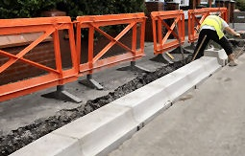
Cheshire East Council proposes to:
Add a 480m concrete kerb
Clear two x 40 linear metre sections of trees from the full width of the embankment and manage as grass
Widen the adjacent footpath, removing tree roots and resurface with compacted gravel
Add a 2m wide grass strip, and remove tree roots from beneath it
Notes:
480m of the dam is the equivalent length of almost five football pitches

Slide 10
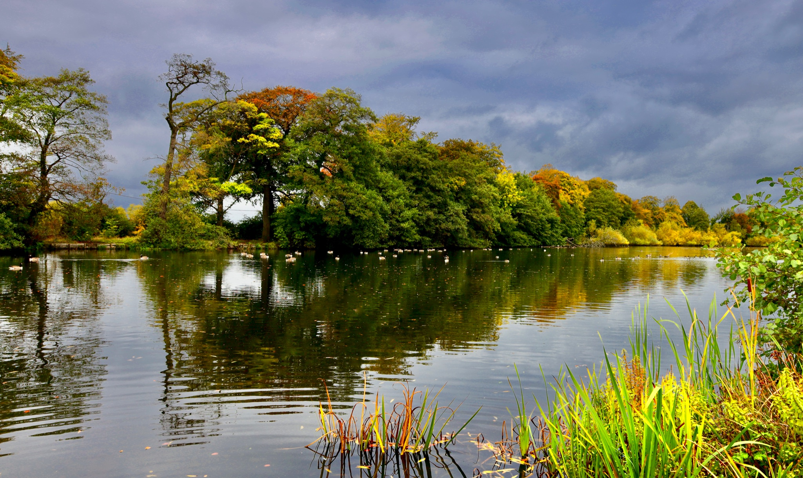
Planning application impact (1 of 2)
The planning officer report identifies 78 trees will be felled (application stated 31 trees) plus two 40m sections of Hawthorn Hedgerow will be removed
A further 49 trees and 10 groups of trees are also impacted
The planning officer says: “The creation of two 40m wide gaps within this prominent roadside woodland … will be a brutal intervention, and unequivocally harmful.”

Slide 11
Planning application impact (2 of 2)
Loss of woodland associated with the proposed development will result in a significant adverse effect upon the Local Wildlife Site (CEC Nature Conservation Officer)
The permanent loss of trees will mean traffic on London Road North and the mid-20th century dwellings to the east will be clearly visible all year round
A 480m concrete kerbstone will be laid by the Pool
Works could severely damage the historic embankment
The scheme will cost of over £1.4m

Slide 12
2019 Flood study
The flood study was a computer model using data on Poynton Pool to test whether the Pool could withstand a 1 in 1000-year design flood event and 1 in 10,000-year safety check flood event
The safety check flood allows for some damage provided the integrity of the embankment is maintained and there is no breach and sudden release of water
The model identified there was a risk of dam failure and was the justification for the proposed works BUT….

Slide 13
Impact Flood study data issues (1 of 2)
Flood Study
Jacobs used previous volume estimates of 130,000m³
Main outflow pipe diameter 450mm
Direct catchment of 1.96km²
Dam composition. Unknown, assumed marl
FoPP Findings
Volume calculated to be 61,500m³
Main outflow pipe diameter 600mm
Direct catchment of 1.00km²
Dam composition. Possibly a permeable weir. Requires investigation
Metric | 2019 Flood Study | Environment Agency | FoPP Findings
Pool volume | 130,000m³ | 130,000m³ | 61,500m³
Direct catchment area | 1.96km² | 1.96km² | 1.00km²
Main outflow pipe diameter | 450mm | ? | 600mm
Dam composition | Unknown. Assumed marl | Unknown | Possibly a permeable weir. Requires investigation
Lowest crest
Water LEvel

Slide 14
Flood study / data issues (2 of 2)
Poynton Pool is a statutory reservoir and therefore must comply with the provision of the Act
Current proposals are based on a flood study that contains significant material errors and inaccurate design data
A revised flood study would inform an alternative solution based on the risks/consequences identified
FoPP have asked that CEC defer their decision for further investigations to be undertaken

Slide 15
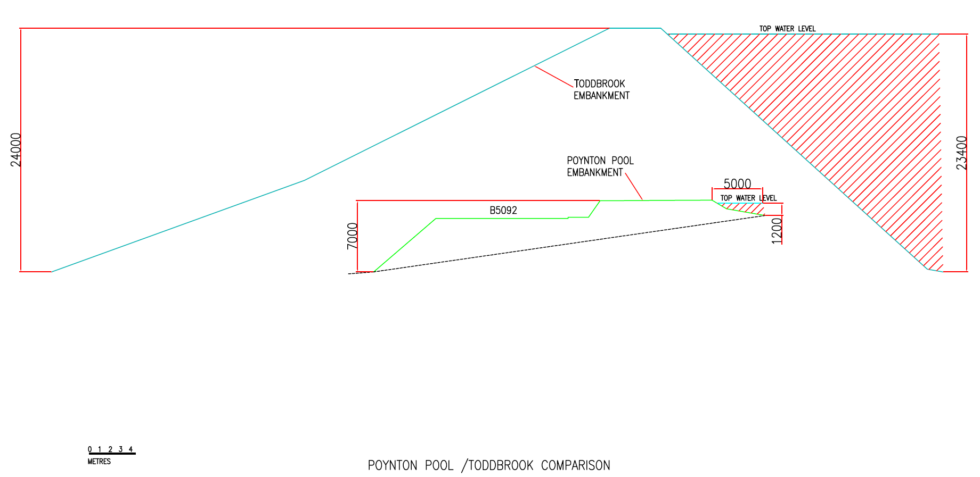
Poynton Pool is a ‘puddle’ compared to Toddbrook reservoir
Toddbrook contains 20 times more water than Poynton Pool

Slide 16
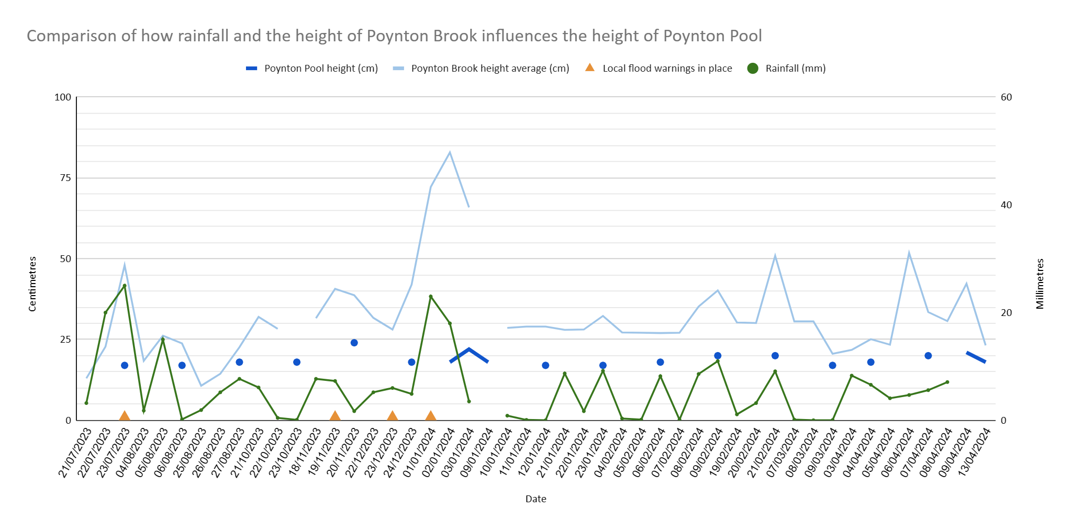
How does rainfall affect Poynton Pool?
Poynton Pool height has varied by a maximum of 7cms in the last 9 months whereas Poynton Brook has varied by 72cms

Slide 17
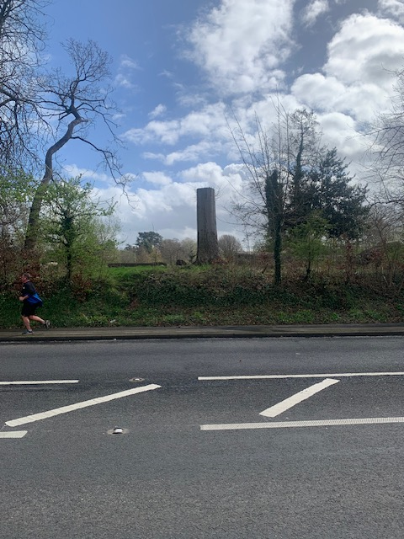
FoPP alternative options (1 of 2)
Produced by a Civil Engineer and Civil and Structural Designer
Two conventional alternative options
Reinforced concrete spillway
Follows line of existing overflow structure and culvert
Double sided weir

Slide 18
FoPP alternative options (2 of 2)
Option 1C
the emergency outfall is onto London Road North (B5092) as with the application proposal
Option 2C
proposes two 1200mm diameter pipes beneath the B5092 to accommodate normal flow and extreme flood events
Both options have been designed to pass the design floods calculated by CEC’s technical advisors

Slide 19
FoPP Option 1C

Slide 20
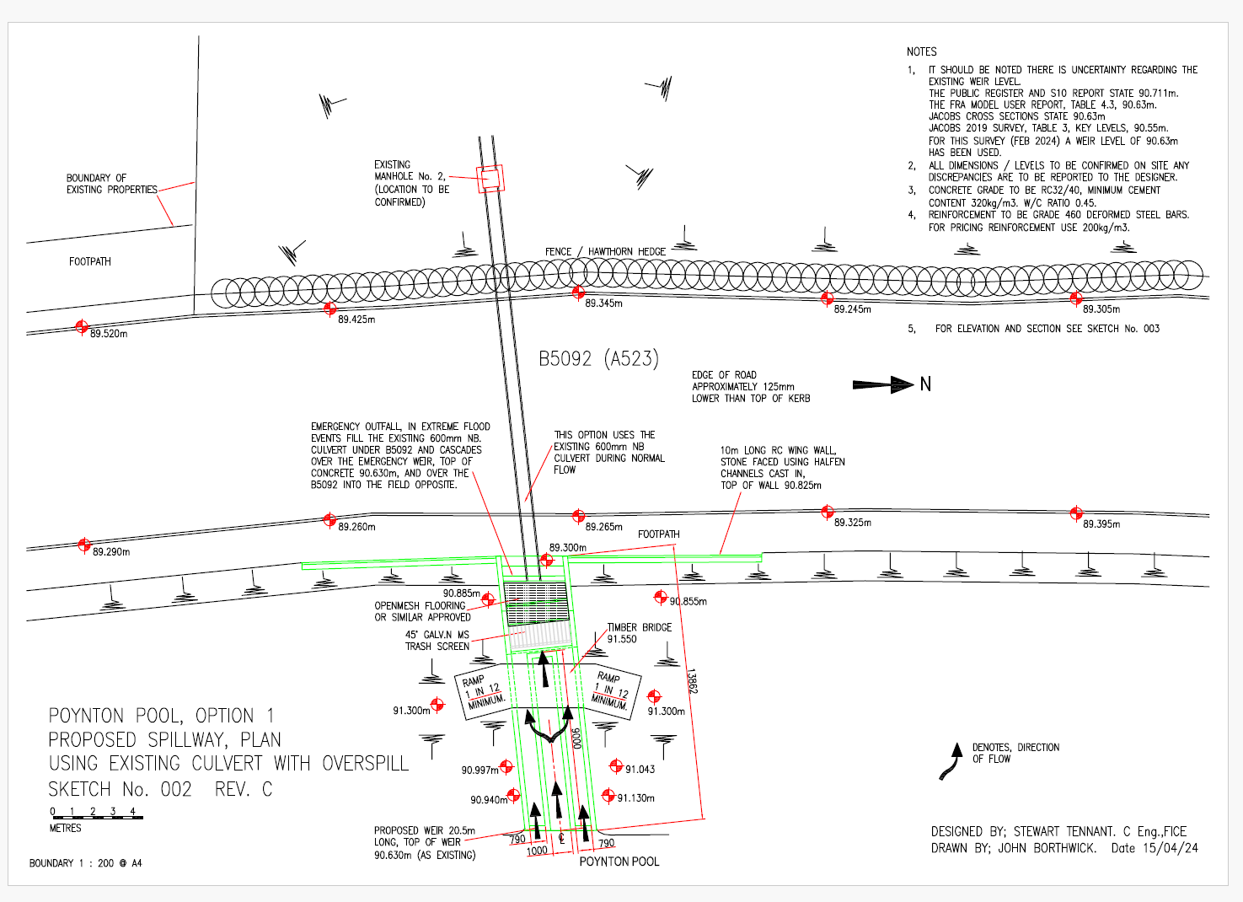

Slide 21
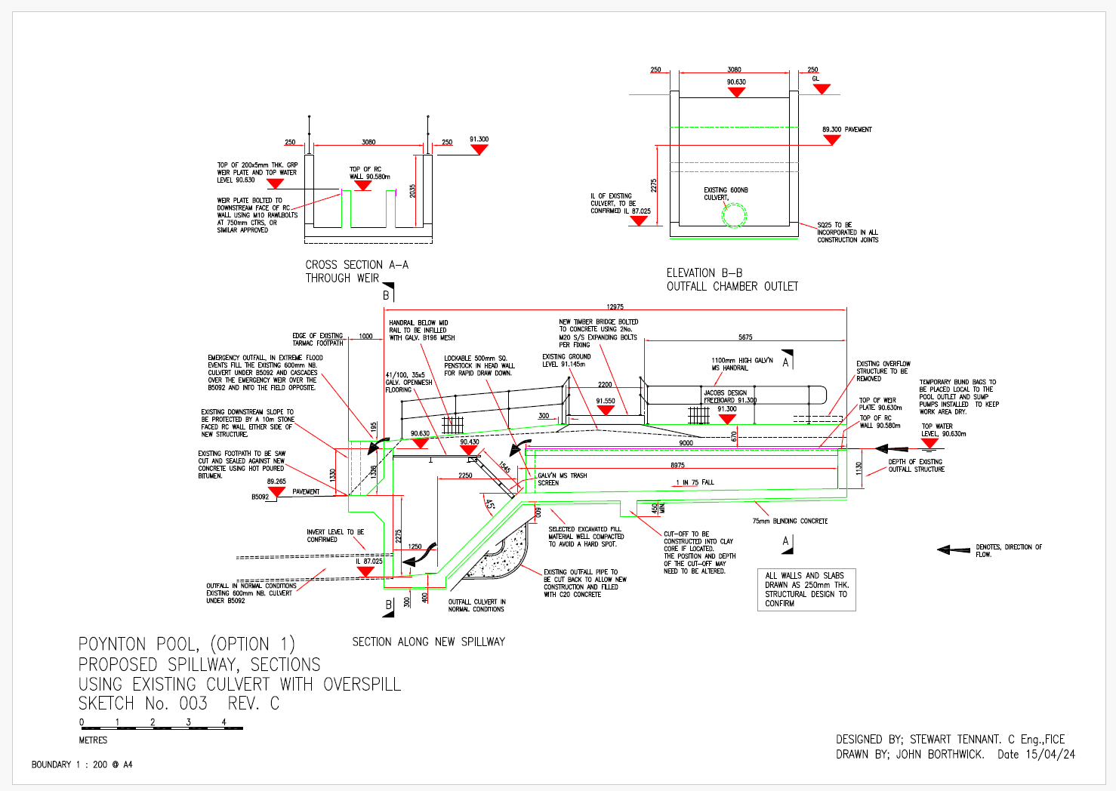

Slide 22
FoPP Option 2C

Slide 23
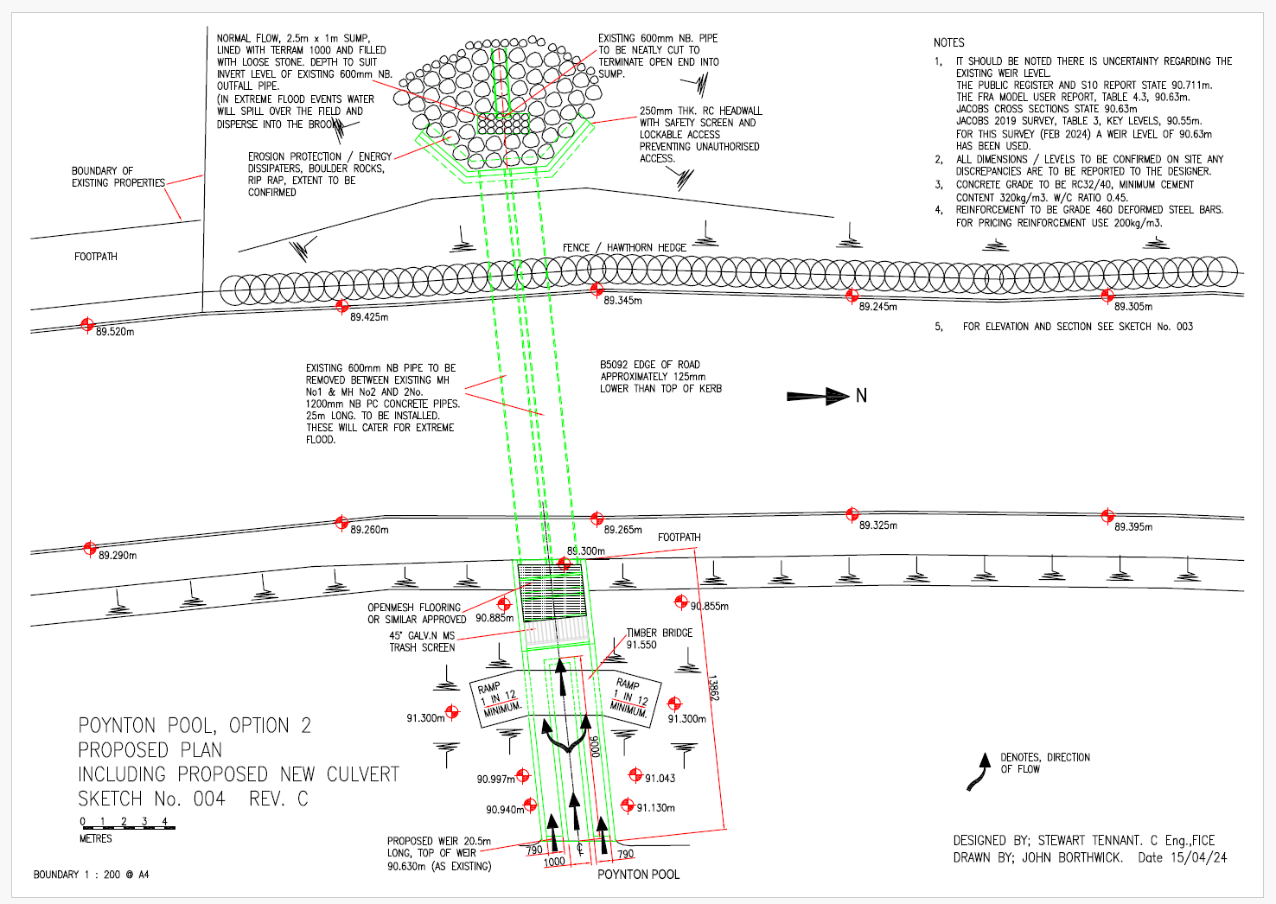

Slide 24
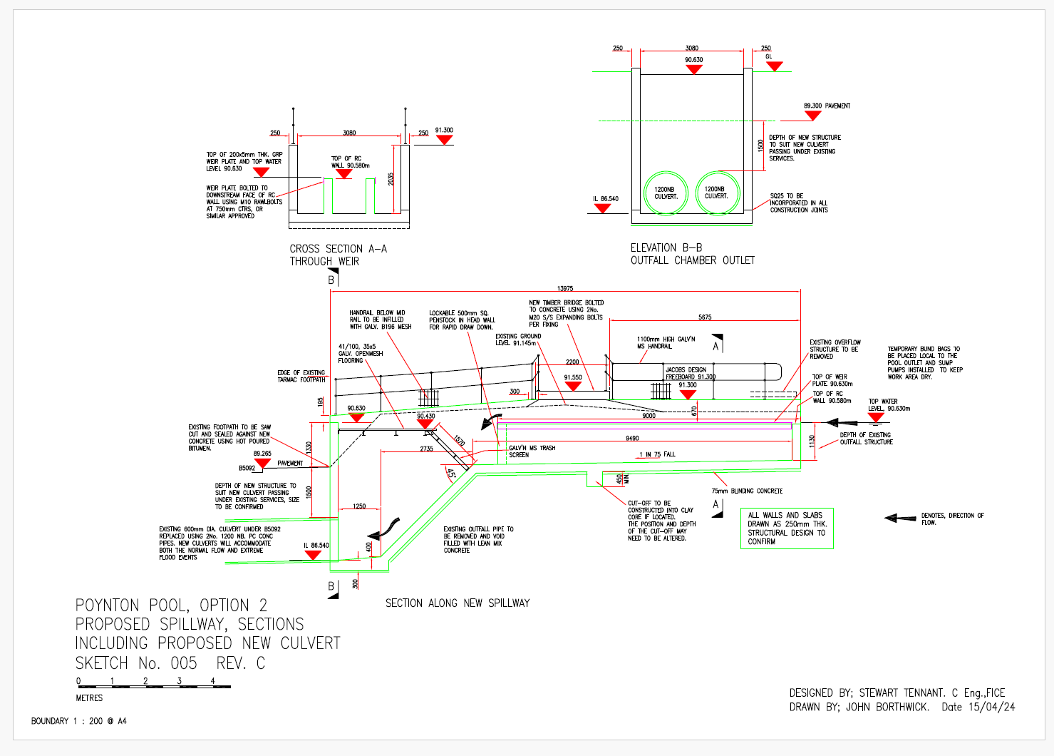

Slide 25
Benefits of FoPP alternative options (1 of 2)
Just a single remnant beech stump will need to be removed and some adjacent minor vegetation
It is anticipated that no further mature trees will be affected by the works with the associated risk of root die back seepage and potentially terminal decline
The emergency drawdown is provided by a simple penstock (sluice) in the base of the weir i.e. no need to mobilise emergency equipment at short notice
It has a 100-year design life with minimal inspection and maintenance required
It is a conventional reservoir overflow solution

Slide 26
Benefits of FoPP alternative options (2 of 2)
The scheme is easy to construct with access direct from London Road North
It incorporates a new Environment Agency compliant trash screen which can be cleaned and directly accessed from the highway
The historic embankment will remain intact
The 480m concrete kerb will not be required
This proposal will not require a costly carbon offset mitigation scheme
The landscape management plan will not be required

Slide 27
Questions?
Strategic Planning Board
10:00 am Wednesday, 24 April 2024
Venue: Council Chamber
Town Hall, Macclesfield, SK10 1EA
If you are planning to attend email: speakatplanning@cheshireeast.gov.uk
If you want to contact Friends of Poynton Pool our email is: friendsofpoyntonpool@gmail.com

